Slide 1

VIT Bhopal University
Bhopal-Indore Highway, Kothri Kalan, Sehore, Madhya Pradesh – 466114.
Introduction to Problem Solving and Programming
Course Code: CSE 1021
By:
Shrishtika Raikwar

Slide 2
Chapters
Introduction to Computer Problem Solving
Python Data, Expressions and Statements
Fundamental Algorithms & Python Control Flow, Functions
Factoring Methods
Array Techniques & Python Lists

Slide 3
Textbooks
Dromey R G, “How to Solve it by Computer”, PHI
C. Dierbach, Introduction to Computer Science Using PYTHON: A Computational Problem Solving Focus (1 ed.), Wiley, 2015. ISBN 978-0470555156.
A.R. Bradley, "Programming for Engineers", Springer, 2011
Yashavant Kanetkar, Let Us Python (1 ed.), BPB Publishers, 2019. ISBN 978-9388511568.

Slide 4
Chapter 1: Introduction to Computer Problem Solving
– Introduction
– Problem Solving Aspect
– Top-Down Design
– Implementation of Algorithms (flowcharts, pseudo code, programming language)
– Program Verification
– Efficiency of Algorithms
– Analysis of Algorithms.

Slide 5
Learning Objectives
To understand the concept of Problem solving
To understand steps involved in algorithm development
To understand the concept of Algorithm
Develop Algorithm for simple problem
To understand the concept of Flowchart development
Draw the symbols used in Flowchart

Slide 6
Introduction to Problem Solving Aspects

Slide 7
Introduction to Problem Solving Aspects
Today, computers are all around us. We use them for doing various tasks in a faster and more accurate manner.
For example, using a computer or smartphone, we can book train tickets online.
Que: What information is required for booking train tickets?
Ans:
Source and Destination city
Schedule Date
Train Name and number
Coach type
Berth type
Details of the Passengers

Slide 8
Cont.
A computer is a dumb machine.
A computer cannot do anything alone.
Que: What are the types of Softwares?
Ans:
System Software
Application Software
Ques: How Computer Works?
Ans: It need some softwares.

Slide 9
Cont.
A software is a set of programs written to solve a particular problem
Software is a set of instructions on the basis of which computer gives output/result.
If the instructions are not correct, the computer gives wrong result.
Program must be planned before coding in any computer language available.

Slide 10
Steps Involved in Problem Solving
Requirements specifications (Specification of needs).
Problem analysis.
Design the algorithm to solve the problem.
Implementation.
Testing and verification.
Documentation

Slide 11
Requirements specifications
State the problem clearly and unambiguously (Doubtless) to understand exactly:
What the problem is?
What is needed to solve it?
What the solution should provide
If there are constraints and special conditions

Slide 12
Problem analysis
In the analysis phase, we need to read and analyse the problem statement carefully in order to list the principal components of the problem and decide the core functionalities that our solution should have. We should identity the following:
Inputs: To the problem, their form and the input media to be used.
Outputs: Expected from the problem, their form and the output media to be used.
Special constraints or (necessity) conditions (if any).
Formulas or equations to be used.

Slide 13
Design the algorithm to solve the problem.
A set of sequential steps usually written in Ordinary Language to solve a given problem is called Algorithm.
It may be possible to solve to problem in more than one ways, resulting in more than one algorithm.
The choice of various algorithms depends on the factors like reliability, accuracy and easy to modify.
An algorithm is a list of steps to be executed with the right order in which these steps should be executed.

Slide 14
Ex.
153 number
1, 5, 3 digits in our no.
1, 125, 27 cubes of these digits
1+125+27= 153
153==153
No is an armstrong no.
153
1, 5,3
1+5+3 =9
729
729==153
No is not an armstrong no.

Slide 15
Example:
Que: Design an algorithm to find the sum of 2 numbers?
Ans:
Step 1: Start
Step 2: Assume two numbers x and y and a variable sum=0
Step 3: Add two numbers x and y; store the value in variable sum
Step 4: If you want to try again with different numbers then
goto step 2
else
goto step 5
Step 5: End

Slide 16
Example:
Que: Design an algorithm to find the sum of 2 numbers?
Ans:
Step 1: Start
Step 2: Declare variables num1, num2 and sum.
Step 3: Read values num1 and num2.
Step 4: Add num1 and num2 and assign the result to sum.
sum←num1+num2
Step 5: Display sum
Step 6: Stop

Slide 17
Implementation or Coding
The process of transforming the program logic design into computer language format.
The code written using programming language is also known as source code.
Implementation or Coding isn’t the only task to be done to solve a problem using computer.
Anyone can code. TRUST ME!!

Slide 18
Testing and Verification
Program testing is the process of executing a program to demonstrate its correctness.
Program verification is the process of ensuring that a program meets user requirement.
After the program is compiled we must run the program and test/verify it with different inputs before the program can be released to the public or other users

Slide 19
Documentation
Why Documentation?
It helps to those who use, maintain and extend the program in future.
A program may be difficult to understand even to programmer who wrote the code after some days.
Properly documented program is necessary which will be useful and efficient in debugging, testing, maintenance and redesign process.

Slide 20
Steps Involved in Problem Solving
Requirements specifications (Specification of needs).
Problem analysis.
Design the algorithm to solve the problem.
Implementation.
Testing and verification.
Documentation

Slide 21
Steps involved in algorithm development
Step1. Identification of input
Step2: Identification of output
Step3 : Identification the processing operations
Step4 : Processing Definiteness
Step5 : Processing Finiteness
Step6 : Possessing Effectiveness

Slide 22
Steps involved in algorithm development
Step1: Identification of input: For an algorithm, there are quantities to be supplied called input and these are fed externally. The input is to be identified first for any specified problem.
Step2: Identification of output: From an algorithm, at least one quantity is produced, called for any specified problem.
Step3: Identification the processing operations: All the calculations to be performed in order to lead to output from the input are to be identified in an orderly manner.

Slide 23
Steps involved in algorithm development
Step4: Processing Definiteness: The instructions composing the algorithm must be clear and there should not be any ambiguity in them.
Step5: Processing Finiteness: If we go through the algorithm, then for all cases, the algorithm should terminate after a finite number of steps.
Step6: Possessing Effectiveness: The instructions in the algorithm must be sufficiently basic and in practice they can be carries out easily.

Slide 24
Characteristics of a good algorithm
Precision: the steps are precisely stated or defined.
Uniqueness: results of each step are uniquely defined and only depend on the input and the result of the preceding steps.
Generality: The algorithm must be complete in itself so that it can be used to solve problems of a specific type for any input data.
Effectiveness: Each step must be effective, in the sense that it should be primitive easily convert able into program statement) can be performed exactly in a finite amount of time.
Finiteness: the algorithm always stops after a finite number of steps.
Input: the algorithm receives some input.
Output: the algorithm produces some output.

Slide 25
Top Down Design
List the major steps:
Get the data.
Perform the computations.
Display the result.
Perform algorithm refinement the step(s) may need to be broken down into a more detailed list of steps.
Verify that the algorithm works as intended – perform desk check.

Slide 26
Top Down Design
It must be correct and it must solve the problem for which it is designed.
It must execute and terminate in a finite amount of time.
It must be efficient enough so that it can solve the intended problem using the resource currently available on the computer.
Specifying the order in which the steps are to be executed is important.
An algorithm can be represented using Pseudo codes (or) Flow charts.

Slide 27
Example:
Algorithm for getting out of bed and prepare to go to college.
Sequence 1:
Get out of Bed.
Take Shower.
Get Dressed.
Sequence 2:
Get out of Bed.
Get Dressed.
Take Shower.
What would be the result?

Slide 28
Example 1:
Que: Suppose we want to find the average of three numbers, the algorithm is as follows?
Ans:
Step 1: Read the numbers a, b, c
Step 2: Compute the sum of a, b and c
Step 3: Divide the sum by 3
Step 4: Store the result in variable d
Step 5: Print the value of d
Step 6: End of the program

Slide 29
Example 2:
Que: Write an algorithm to calculate the simple interest using the formula.
Simple interest = P*N* R/100, where P is Principle Amount, N is the number of years and R is the rate of interest ?
Ans:
Step 1: Read the three input quantities’ P, N and R.
Step 2 : Calculate simple interest as
Simple interest = P* N* R/100
Step 3: Print simple interest.
Step 4: Stop.

Slide 30
Example 3:
Que: Write an algorithm to calculate the perimeter and area of rectangle. Given its length and width?
Ans:
Step 1: Read length of the rectangle, l
Step 2: Read width of the rectangle, w
Step 3: Calculate perimeter of the rectangle (p) using the formula p = 2* (l +w)
Step 4: Calculate area of the rectangle (ar) using the formula ar = l * w
Step 5: Print perimeter, p
Step 6: Print area. ar
Step 7: Stop.

Slide 31
Example 4:
Que: Write down an algorithm to find the largest data value of a set of given data value?
Ans:
Step 1: LARGE = 0
Step 2: read NUM = 10
Step 3: While 10 > = 0 do (true)
3.1 if NUM > LARGE (25>10) true
3.1.1 then
3.1.1.1 LARGE = 25
3.2. Read NUM = 25
Step 4: Write “largest data value is”, LARGE
Step 5: End.

Slide 32
Complexities of an Algorithm
The complexity of an algorithm computes the amount of time and spaces required by an algorithm for an input of size (n).
Time Complexity of an Algorithm
The time complexity is defined as the process of determining a formula for total time required towards the execution of that algorithm. This calculation is totally independent of implementation and programming language.
Space Complexity of an Algorithm
Space complexity is defined as the process of defining a formula for prediction of how much memory space is required for the successful execution of the algorithm. The memory space is generally considered as the primary memory.

Slide 33
Representation of Algorithm
Flow Charts
Pseudo Codes

Slide 34
Flow Charts
A flow chart is a
step by step diagrammatic representation of the logic paths to solve a given problem.
visual or graphical representation of an algorithm.
pictorial representation of the methods to be used to solve a given problem.
help a great deal to analyze the problem and plan its solution in a systematic and orderly manner.

Slide 35
Advantages of Flow Chart
1. The flowchart shows the logic of a problem displayed in pictorial fashion which felicitates easier checking of an algorithm.
2. The Flowchart is good means of communication to other users. It is also a compact means of recording an algorithm solution to a problem.
3. The flowchart allows the problem solver to break the problem into parts. These parts can be connected to make master chart.
4. The flowchart is a permanent record of the solution which can be consulted at a later time.

Slide 36
Symbols Used in Flow Chart
Oval:
Also called ‘Terminator’ symbol. Used to indicate start and end of the flow.
Input and output indicators:
Also called ‘Data’ symbol. Statements like INPUT, READ and PRINT are represented in these Parallelograms.

Slide 37
Symbols Used in Flow Chart
Process:
Also called ‘Action’ symbol. It indicates a process action such as for storing arithmetic operations.
Decision Maker:
A decision or branching point, usually a yes/no or true/ false question is asked, and based on the answer, the path gets split into two branches.

Slide 38
Symbols Used in Flow Chart
Arrow or Flow Lines:
Connector to show order of flow between shapes, or the direction being followed in the flowchart.

Slide 39
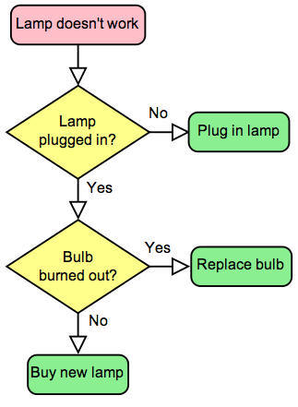
Example:
Draw a flowchart to solve the problem of a non-functioning lamp?

Slide 40
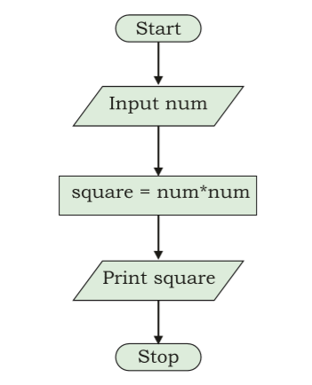
Example 1:
Que: Write an algorithm to find the square of a number.
Step 1: Input a number and store it to num. Step 2: Compute num * num and store it in square.
Step 3: Print square.

Slide 41
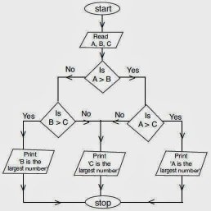
Example 2:
Que: Draw a flowchart to find out the biggest of the three unequal positive numbers.

Slide 42
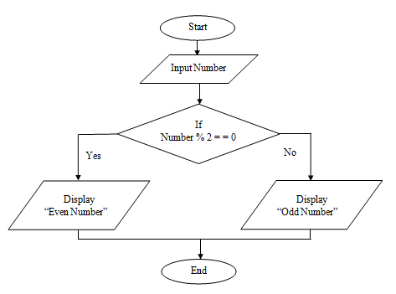
Example 3:
Que: Draw flowchart to test a number for even or odd?

Slide 43
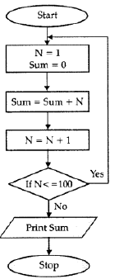
Example 4:
Que: Draw a flowchart for adding the integers from 1 to 100 and to print the sum?
ex.
for (int N=1; initialization
N<=100; Condition
N++) increment
Sum= 1+2+3+....100 = ?

Slide 44
Pseudo Code
A pseudocode (pronounced Soo-doh-kohd, the word “pseudo” means “not real,” so “pseudocode” means “not real code”. ) is another way of representing an algorithm.
Its is neither an algorithm nor a program. It is an abstract form of a program.
It consists of English like statements which perform the specific operations.
It helps programmers to write algorithm.
It is a detailed description of instructions that a computer must follow in a particular order.
Advantages: * Easy to read, * Easy to understand, * Easy to modify.

Slide 45
Example
Que: Write a pseudo code to perform the basic arithmetic operations.
Start
Read n1, n2
Sum = n1 + n2
Diff = n1 – n2
Mult = n1 * n2
Quot = n1/n2
Print sum, diff, mult, quot
End.

Slide 46
Example
Que: Write a Pseudocode for calculating area and perimeter of a rectangle.
INPUT length
INPUT breadth
COMPUTE Area = length * breadth
PRINT Area
COMPUTE Perim = 2 * (length + breadth)
PRINT Perim
INPUT
COMPUTE
PRINT
INCREMENT
DECREMENT
IF/ELSE
WHILE
TRUE/FALSE

Slide 47
Comparison between Algo and Pseudo Code
Step 1: Read length of the rectangle, l
Step 2: Read width of the rectangle, w
Step 3: Calculate perimeter of the rectangle (p) using the formula p = 2* (l +w)
Step 4: Calculate area of the rectangle (ar) using the formula ar = l * w
Step 5: Print perimeter, p
Step 6: Print area. ar
Step 7: Stop.
INPUT length
INPUT breadth
COMPUTE Area = length * breadth
PRINT Area
COMPUTE Perim = 2 * (length + breadth)
PRINT Perim

Slide 48
Steps Involved in Problem Solving
Requirements specifications (Specification of needs).
Problem analysis.
Design the algorithm to solve the problem.
Implementation.
Testing and verification.
Documentation

Slide 49
Implementation Or Coding
Computer Program and Programming Language
Low Level Language
Machine Level
Assembly Level
High Level Language

Slide 50

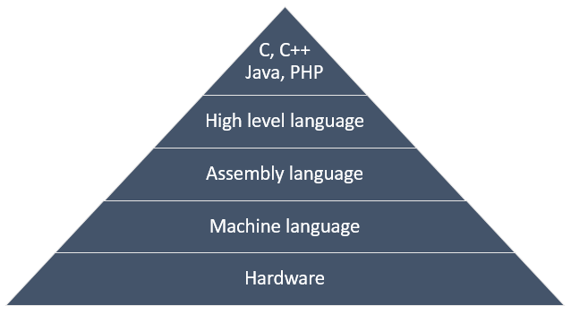
Hierarchy

Slide 51
Low Level Languages
The low-level language is a programming language that provides no abstraction from the hardware.
Represented in 0 or 1 forms, which are the machine instructions.
The languages that come under this category are:
Machine level language
Assembly language

Slide 52
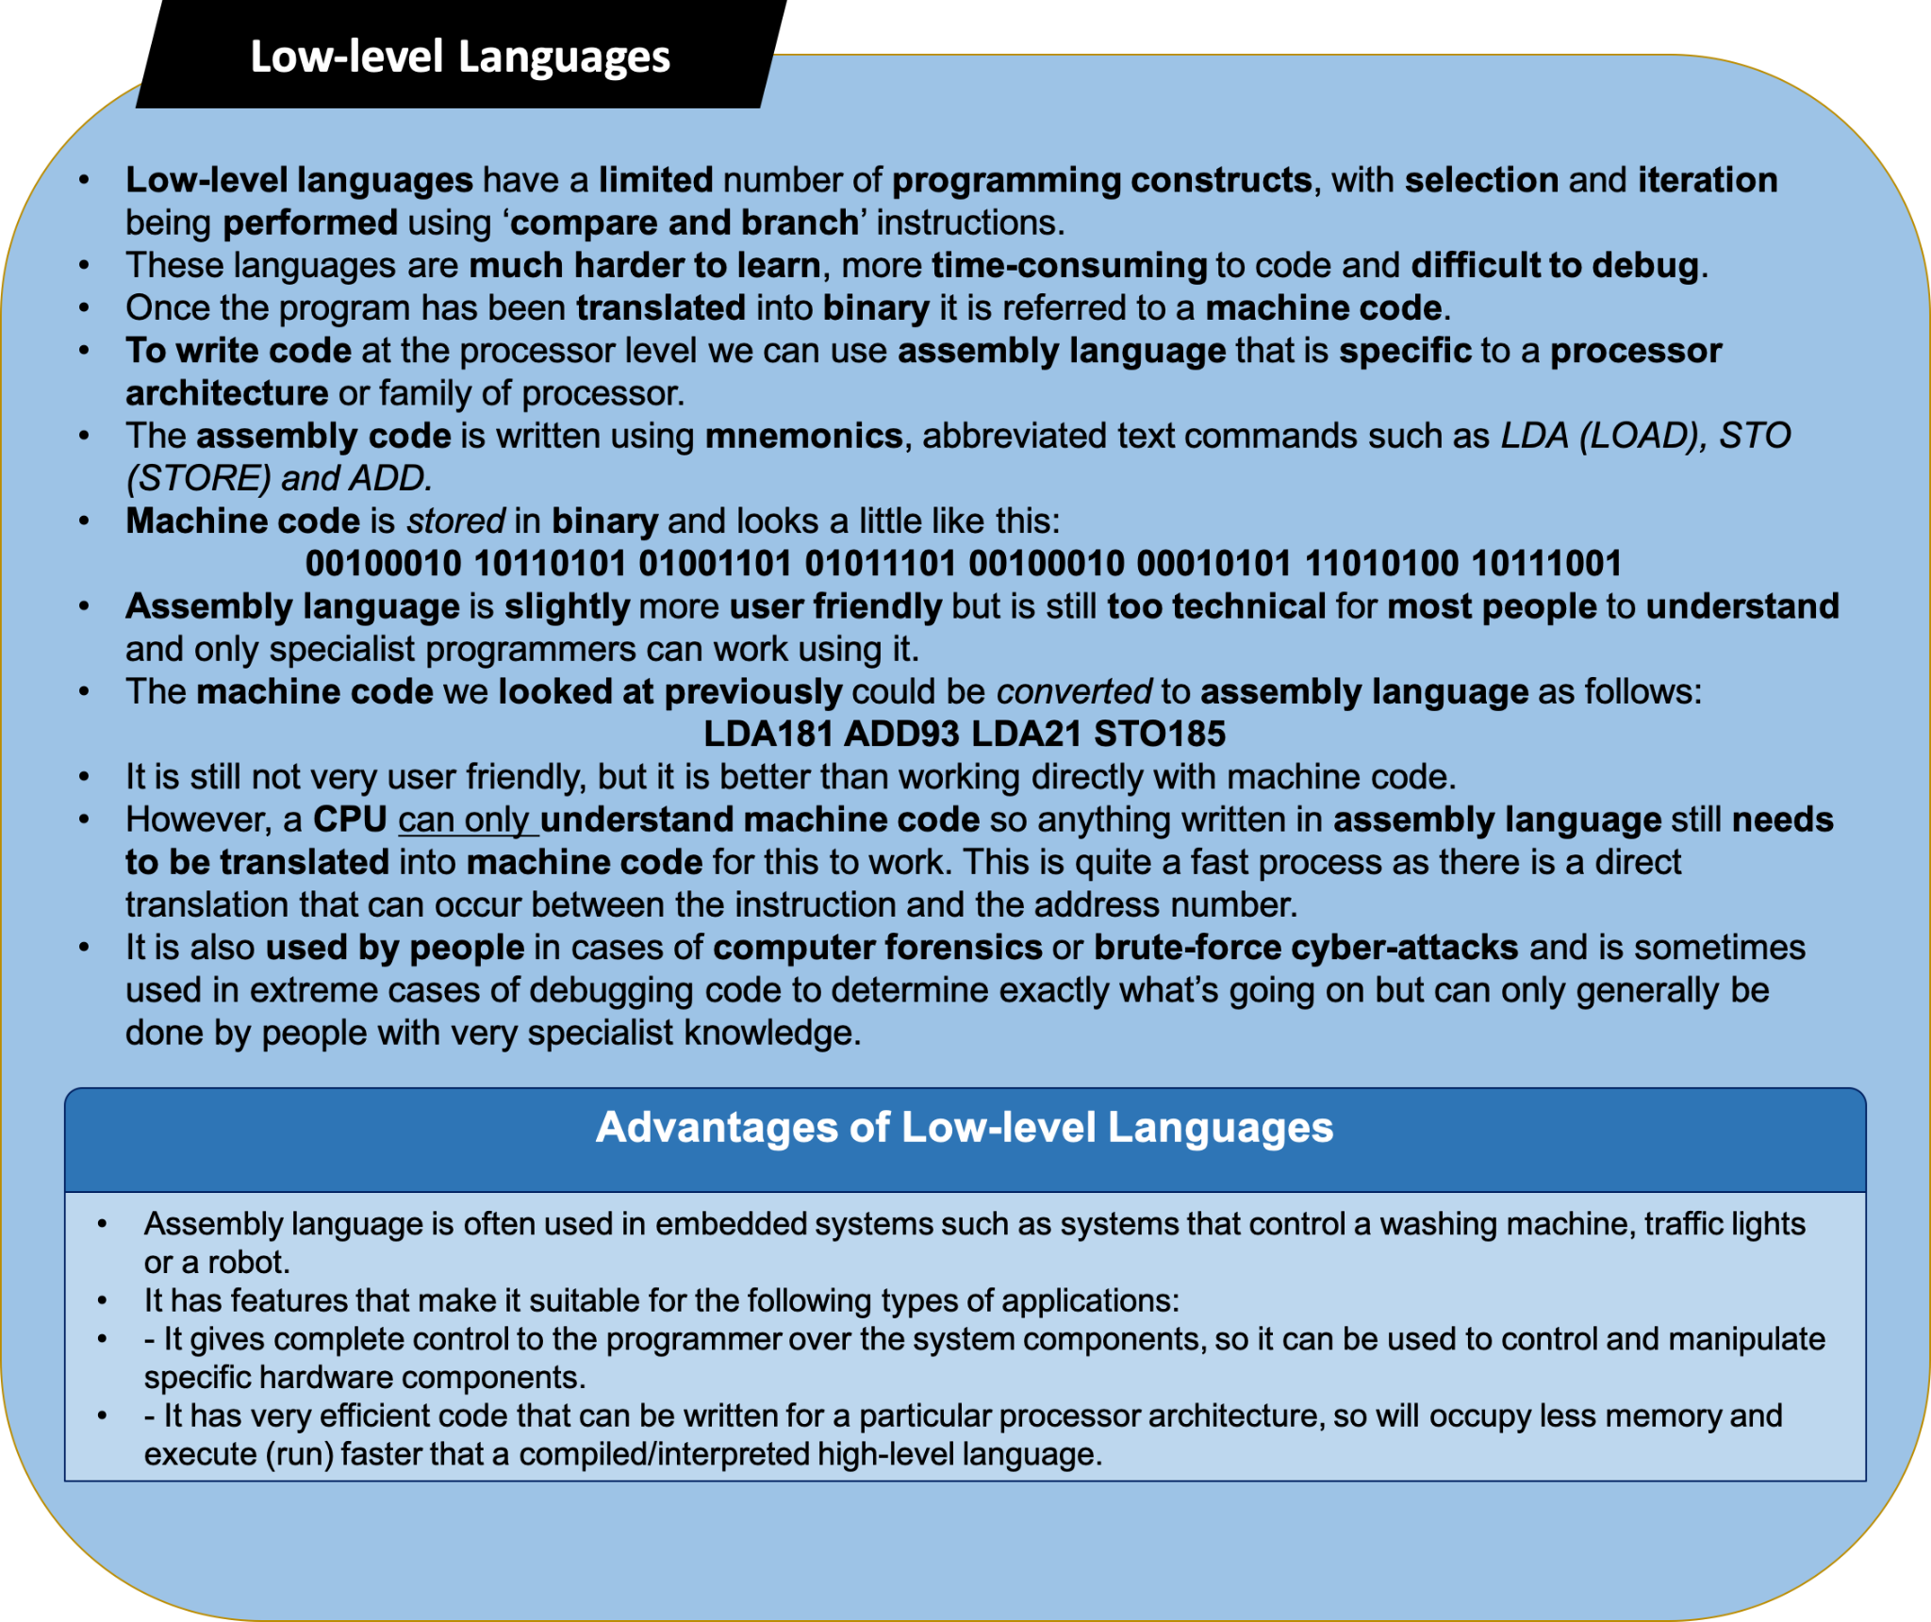

Slide 53
Machine Level Languages
Imagine them as the “native tongue” of the computer, the language closest to the hardware itself.
Each unique computer has a unique machine language.
A machine language program is made up of a series of binary patterns (e.g., 01011100) which represent simple operations that can be accomplished by the computer.
Machine language programs are executable, meaning that they can be run directly.
Programming in machine language requires memorization of the binary codes and can be difficult for the human programmer.

Slide 54
Assembly Level Language
They represent an effort to make programming easier for the human.
The machine language instructions are replaced with simple pneumonic abbreviations (e.g., ADD, MOV).
Thus assembly languages are unique to a specific computer (machine).
Prior to execution, an assembly language program requires translation to machine language.
This translation is accomplished by a computer program known as an Assembler. Assemblers are written for each unique machine language.

Slide 55
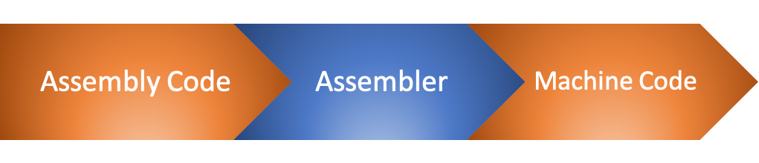
Assembler
An assembler translates assembly language into machine code and is effectively a compiler for the assembly language, but can also be used interactively like an interpreter.
Assembly language uses words called ‘mnemonics’, such as LOAD, STORE and ADD. The instructions are specific to the hardware being programmed because different CPUs use different programming languages.
Finally, every assembly language instruction is translated into a single machine code instruction.

Slide 56
High Level Language
High-level languages, like C,C++, JAVA, PYTHON etc., are more English-like and, therefore, make it easier for programmers to “think” in the programming language.
High-level languages also require translation to machine language before execution.
This translation is accomplished by either a compiler or an interpreter.

Slide 57
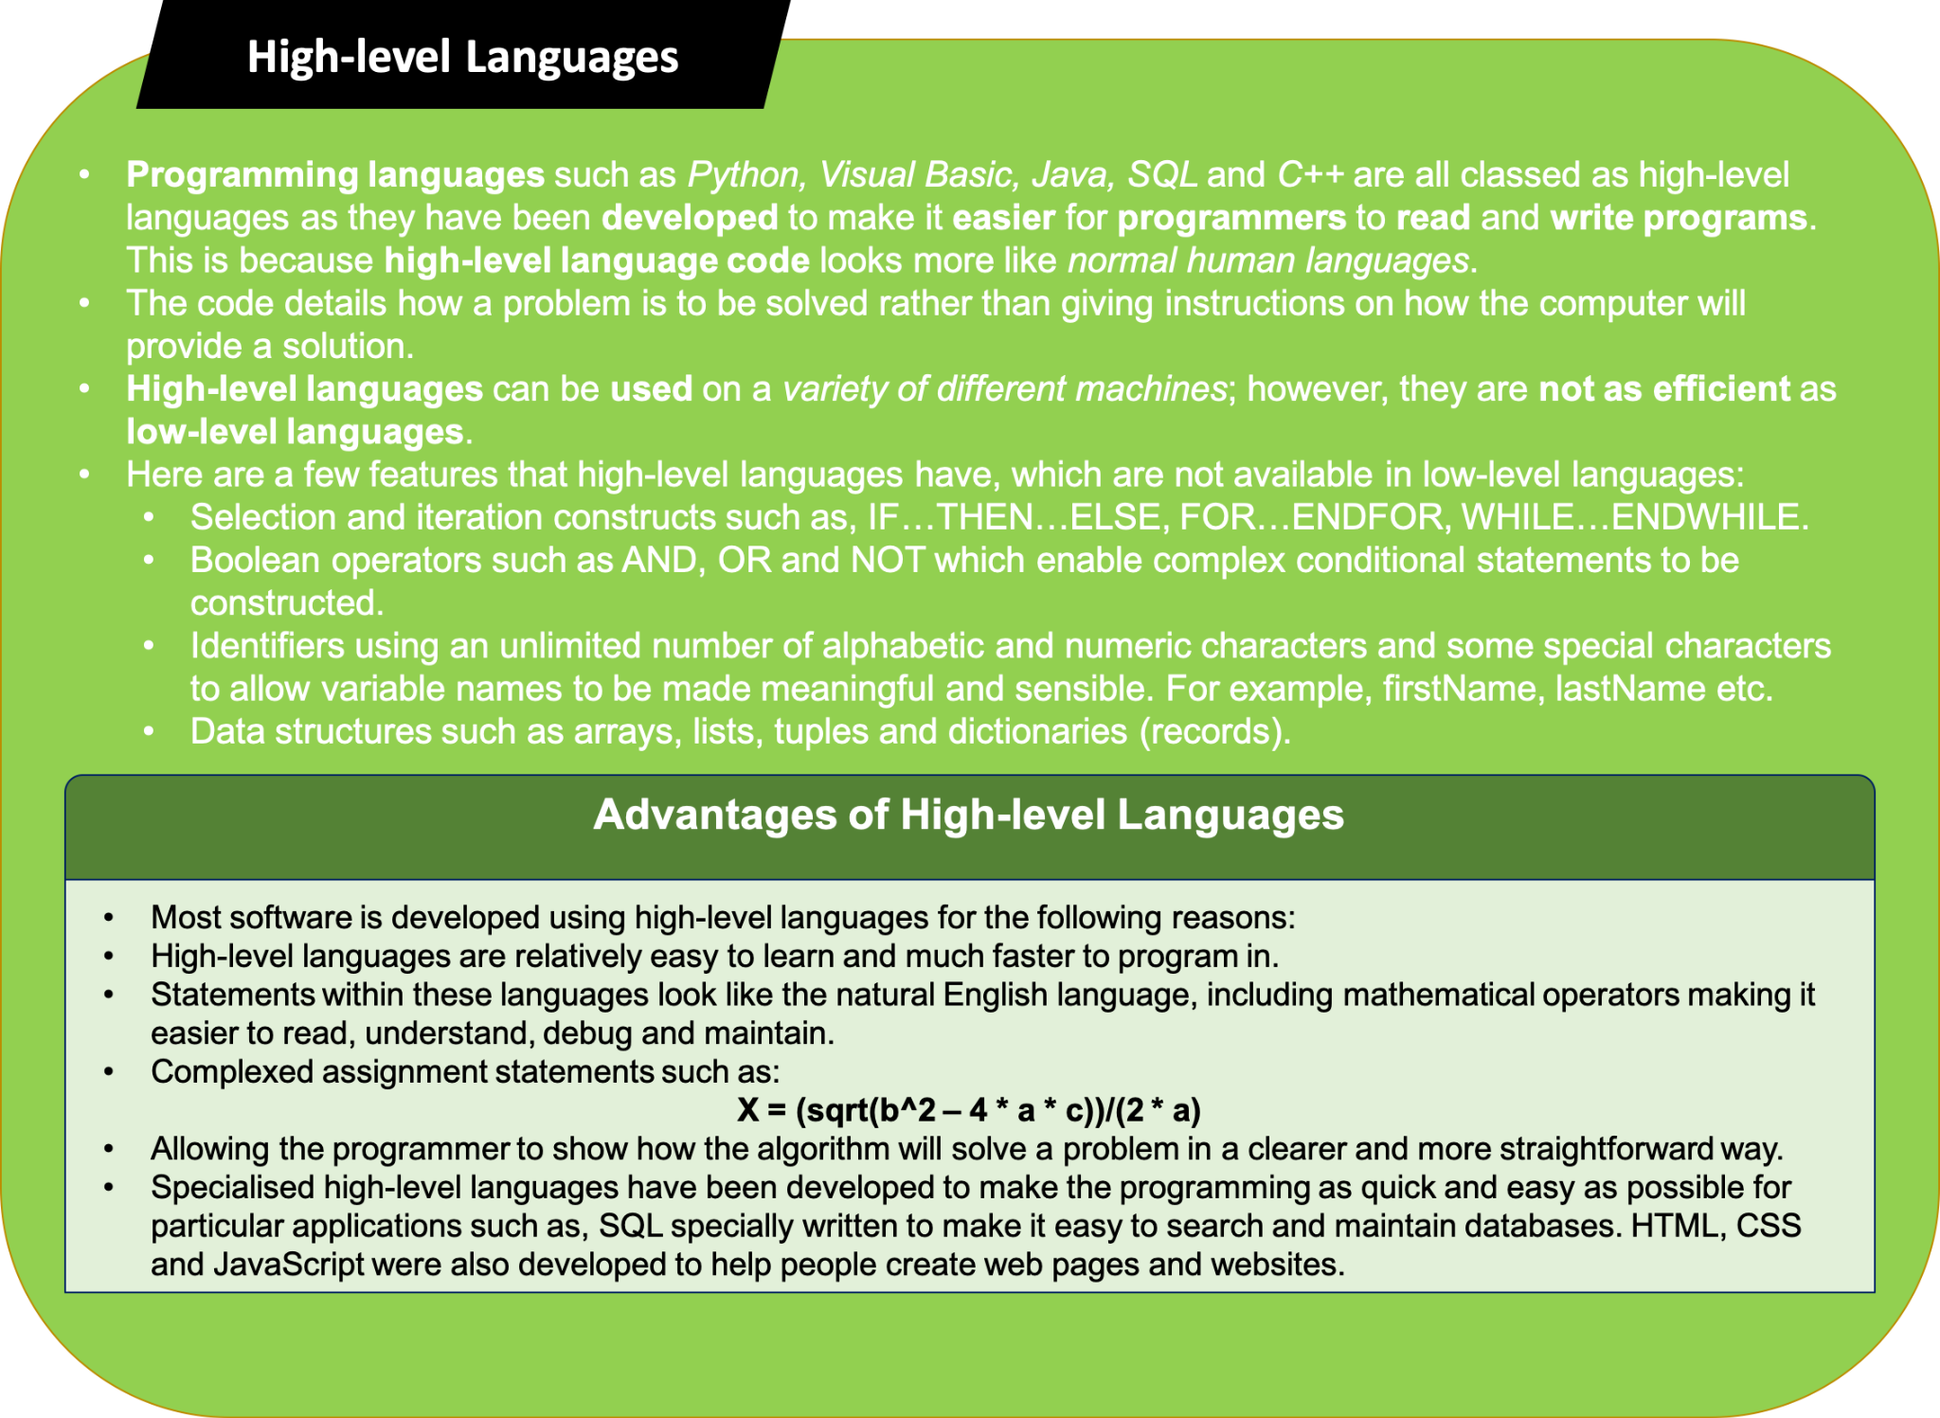

Slide 58
Compilation
Process of changing high level language into machine level language.
It is done by special software, COMPILER
The compilation process tests the program whether it
contains syntax errors or not.
If syntax errors are present, compiler can not compile the code.

Slide 59
Execution
Once the compilation is completed then the program is linked with other object programs needed for execution, thereby resulting in a binary program and then the program is loaded in the memory for the purpose of execution and finally it is executed.
The program may ask user for inputs and generates outputs after processing the inputs.

Slide 60
Steps Involved in Problem Solving
Requirements specifications (Specification of needs).
Problem analysis.
Design the algorithm to solve the problem.
Implementation.
Testing and Verification.
Documentation

Slide 61
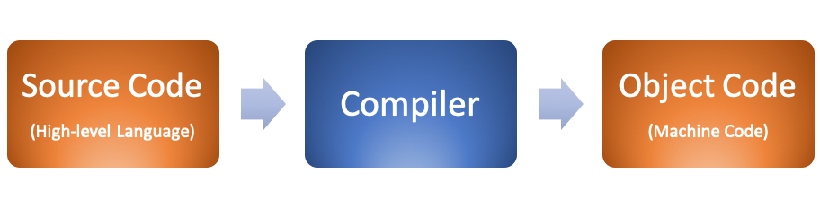
How to execute the high-level program
Compilers translate the entire source code program before execution.(Eg: C++, Java)
Interpreters translate source code programs one line at a time. (Eg: Python) Interpreters are more interactive than compilers.

Slide 62
Testing and Verification
Testing ensures that program performs correctly the required task.
Verification ensures that program does what the programmer intends to do.
Validation ensures that the program produces the correct results for a set of test data.
Test data are supplied to the program and output is observed.
Expected output = Error free

Slide 63
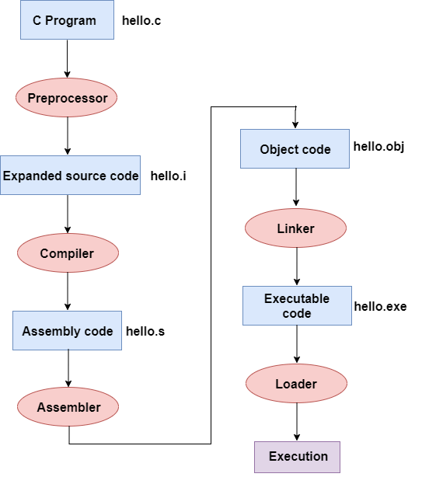
Compilation in ‘C’

Slide 64
Steps Involved in Problem Solving
Requirements specifications (Specification of needs).
Problem analysis.
Design the algorithm to solve the problem.
Implementation.
Testing and Verification.
Documentation

Slide 65
Documentation
Documentation should be from the point of view of the reader
Document should be unambiguous
There should be no repetition
Industry standards should be used
Documents should always be updated

Slide 66
Types of Documentation
User manual (User’s Documentation)
Technical Documentation (Programmer’s Documentation)
Operational manual
Design Document
Requirements Document
Testing Document
List of Known Bugs

Slide 67
Advantages of Documentation
Keeps track of all parts of a software or program
Maintenance is easier
Programmers other than the developer can understand all aspects of software
Improves overall quality of the software
Assists in user training
Ensures knowledge decentralization, cutting costs and effort if people leave the system abruptly

Slide 68
Problem 1:
Following are the conditions for selecting Trainee Officers in an organization.
The candidate must –
(i) be a graduate in any discipline with at least 55% marks.
(ii) has secured at least 60% marks in class 12.
(iii) be at least 22 years and not more than 29 years as on 1.1.2016
(iv) have secured at least 40% marks in the selection examination
(v) have secured at least 50% marks in personal interview
(v) be ready to sign a bond for 2 years.
In the case of candidate who fulfills all conditions except –
(a) At (i) above, but is a qualified CA, the case is to be referred to ED.
(b) at (v) above, but has secured at least 60% marks in the selection examination, the case is to be referred to Chairman.
Sunil was born on November 4, 1988. He has secured 67% marks in class 12 and 50% marks in graduation. He also has qualified CA exam. He has secured 50% marks in both the selection examination and personal interviewer. He is ready to sign a bond for 2 years.
A. if the candidate is to be selected
B. if the candidate is not to be selected
C. if the case is to be referred as ED.
D. if the case is to be referred as Chairman.
E. if the data provided are inadequate to take a decision.

Slide 69
Problem 2:
Following are the conditions for selecting a Manager in a company.
The candidate must –
(i) be a graduate in any discipline with at least 55% marks.
(ii) be a post graduate in Management with specialization in Finance with at least 65% marks.
(iii) have work experience of at least 4 years in finance department.
(iv) be at least 26 years and not more than 36 years as on 01-12-2016.
In the case of candidate who fulfills all conditions except –
(a) at (ii) above, but has secured at least 60% marks in post graduate in Management with specialization in Finance and at least 70% marks in graduation, his case to be referred as DGM.
(b) at (iii) above, but has work experience of at least 2 years as Assistant Finance Manager, his case to be referred as GM.
Karan was born on 19th March 1986. He has been working in finance department of an organization for the past 5 years. He has secured 67% marks in B.Com and 75% marks in his post-graduation.
Which of the following will be a course of action if Karan applies?
A. Karan will be selected.
B. Data provided are inadequate to take the decision.
C. Karan will not be selected.
D. Karan will be offered as DGM post.
E. Karan will be offered as GM post.

Slide 70
Efficiency of Algorithm

Slide 71
Time Complexity
Time Complexity of an algorithm is the representation of the amount of time required by the algorithm to execute to completion. Time requirements can be denoted or defined as a numerical function t(N), where t(N) can be measured as the number of steps, provided each step takes constant time.
For example, in case of addition of two n-bit integers, N steps are taken. Consequently, the total computational time is t(N) = c*n, where c is the time consumed for addition of two bits. Here, we observe that t(N) grows linearly as input size increases.

Slide 72
Space Complexity
Space complexity of an algorithm represents the amount of memory space needed by the algorithm in its life cycle.
Space needed by an algorithm is equal to the sum of the following two components
A fixed part that is a space required to store certain data and variables (i.e. simple variables and constants, program size etc.), that are not dependent of the size of the problem.
A variable part is a space required by variables, whose size is totally dependent on the size of the problem. For example, recursion stack space, dynamic memory allocation etc.
Space complexity S(p) of any algorithm p is S(p) = A + S(I) Where A is treated as the fixed part and S(I) is treated as the variable part of the algorithm which depends on instance characteristic I.

Slide 73
Linear Search
Ex. 13,14,16,6,9,25,39,56,2,3….., n elements
o(1) best case (lucky)
o(n) worst case (bad luck)
o(6) average case (somewhere in between)
o(n) worst case (element was not present in the series) (bad luck)

Slide 74
Best , Average, and Worst case Complexity
In computing, the worst, average, and best case of an algorithm depends on the size of the user input value. To understand these terms, let’s go through them one by one.
Best Case Analysis:
In the best case analysis, we calculate the lower bound of the execution time of an algorithm. It is necessary to know the case which causes the execution of the minimum number of operations. In the linear search problem, the best case occurs when x is present at the first location.
The number of operations in the best case is constant. The best-case time complexity would therefore be Θ (1) Most of the time, we perform worst-case analysis to analyze algorithms. In the worst analysis, we guarantee an upper bound on the execution time of an algorithm which is good information.

Slide 75
Best , Average, and Worst case Complexity
Average Case Analysis:
In the average case analysis, we take all possible inputs and calculate the computation time for all inputs. Add up all the calculated values ​​and divide the sum by the total number of entries.
Worst Case Analysis:
In the worst-case analysis, we calculate the upper limit of the execution time of an algorithm. It is necessary to know the case which causes the execution of the maximum number of operations.
For linear search, the worst case occurs when the element to search for is not present in the array. When x is not present, the search () function compares it with all the elements of arr [] one by one. Therefore, the temporal complexity of the worst case of linear search would be Θ (n).

Slide 76
How to calculate time complexity
?

Slide 77
Examples:
Print (“Hello World”)--------------------------- O(1)
For Loop
for (initialisation; conditional; inc/dec operation)
for(i=1; i<=n; i++) i=1 1<=5 True Hello World
{ i=2 2<=5 True Hello World
print (“Hello World”) i=3 3<=5 True Hello World
} i=4 4<=5 True Hello World
O(n) i=5 5<=5 True Hello World
i=6 6<=5 Flase

Slide 78
for(i=n; i>0; i--) O(n) t(n) = n^2 + 2n + 3 O(n^2)
{
statement;
}
for(i= 1; i<n; i=i+2) O(n) i= 1, 3, 5, 7, 9…..n
{
statement;.......................n/2
}

Slide 79
for(i= 1; i<n; i=i*2) O(log (base2) n ) i= 1, 2, 4, 8, 16…..
{ i= 2^0, 2^1, 2^2, 2^3…..2^k
Statement;------------------k times
}
Assuming log (base 2) 8 = 3
i>=n 2^k>=n log (base 2) 2^3
2^k = n 3 log (base 2) 2
log 2^k = log n 3 *1 = 3
K = log(base2) n

Slide 80
Try to Solve
for(i= n; i>1; i=i/2)
{
Statement;
}
for(i= 0; i*i<n; i++)
{
Statement;
}
3. for(i= 1; i<n; i++)
{
Statement;
}
for(j= 1; j<n; j++)
{
Statement;
}

Slide 81
for(i= n; i>1; i=i/2) O(log(base 2)n) i= n, n/2, n/4….n/2^k
{ i= n, n/2^1, n/2^2, n/2^3...n/2^k
Statement;.....k times
}
n/2^k =1 i =20 1
n= 2^k i=10 2
Log n= log 2^k i=5 3
K =Log (base 2)n i=2 4
i=1 X

Slide 82
for(i= 0; i*i<n; i++) i = 0, 1, 2, 3, …. n^1/2
{ i*i= 0, 1, 4, 9, 16…..n
Statement;
}
Assume, i*i>n i^2>n i^2=n i=root(n)
O(root(n))

Slide 83
for(i= 0; i<n; i++)
{
Statement;...............n times
}
for(j= 0; j<n; j++) = n+n= 2n O(n)
{
Statement;...............n times
}

Slide 84
Nested Loop
for(i= 0; i<n; i++)
{
Statement;...............n times
for(j= 0; j<n; j++)
{
Statement;...............n * n times
}
} n+n^2
O(n^2)

Slide 85
How to calculate time and space complexity?
Example 1:
Algorithm SUM(A, n)
Start
s=0----------------------------------------------1
For i=0;i<n;i++---------------------------n+1
s=s+i-------------------------------n
Return s-----------------------------------1
End
Time Complexity
Space Complexity
A=n
n=1
i=1
s=1
S(n)=O(n)
T(n)=1+n+1+n+1
T(n)=2n+3
T(n)=O(n)

Slide 86
How to calculate time and space complexity?
Example 2:
Algorithm ADDMAT(A, B, n)
Start
For i=0;i<n;i++
For j=0;j<n;j++
C[i][j]=A[i][j]+B[i][j]
Return C[i][j]
End
Time Complexity
Space Complexity
T(n)=
T(n)=
T(n)=
T(n)=
T(n)=
T(n)=

Slide 87
How to calculate time and space complexity?
Example 3:
Algorithm MULMAT(A, B, n)
Start
For i=0;i<n;i++
For j=0;j<n;j++
C[i][j]=0
For k=0;k<n;k++
C[i][j]=C[i][j]+A[j][k]*B[K][j]
Return C[i][j]
End
Time Complexity
Space Complexity
T(n)=
T(n)=
T(n)=
T(n)=
S(n)=

Slide 88
Flow Charts

Slide 89
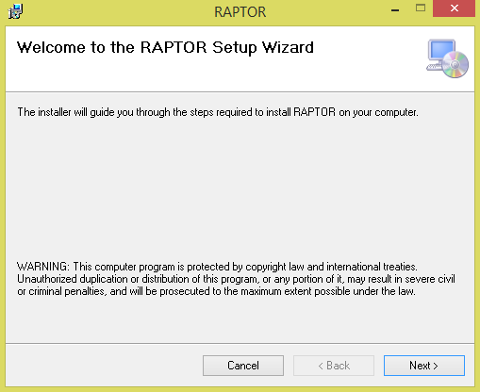

Slide 90
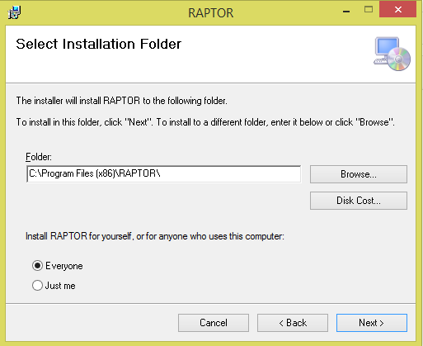

Slide 91
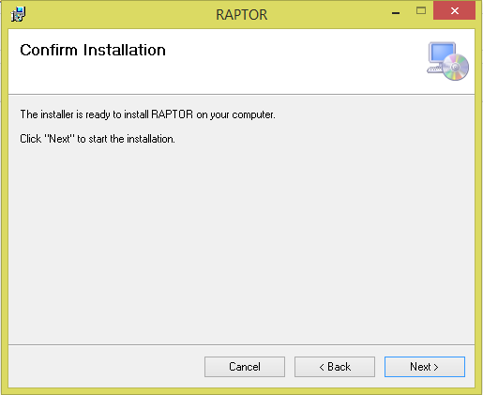

Slide 92
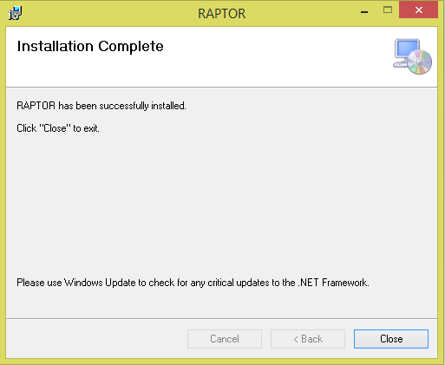

Slide 93
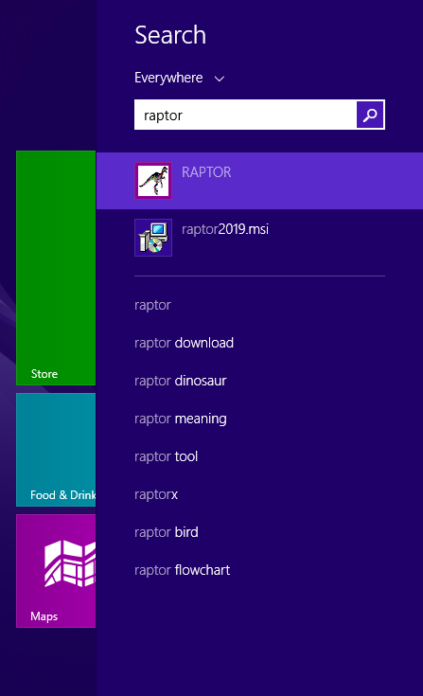
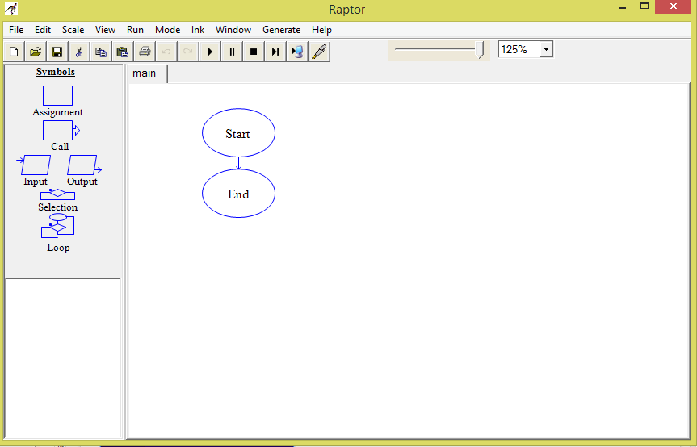

Slide 94
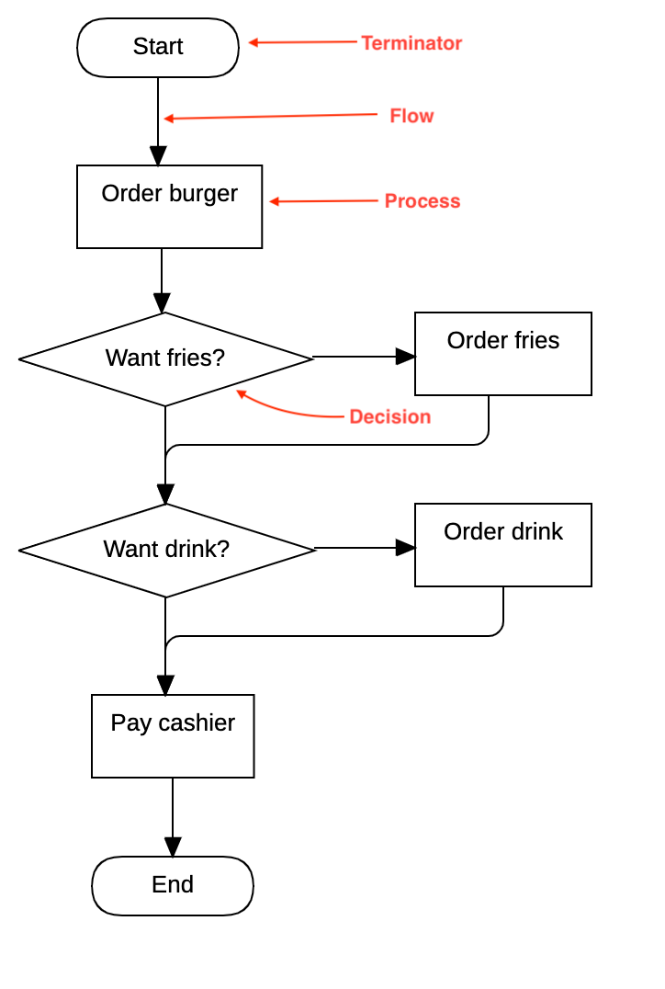
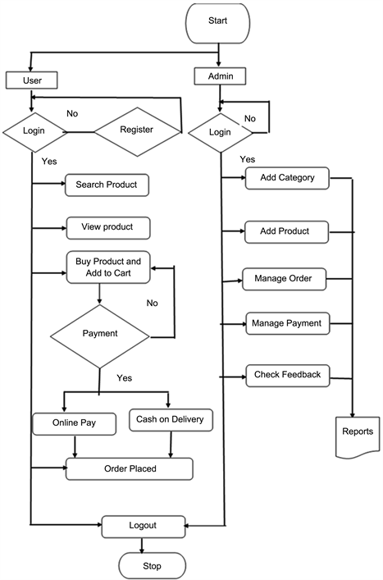
How to draw these flowcharts ?

Slide 95
Assignment 1
Difference between Compiler and Interpreter.
Difference between Machine Level and Assembly Level Language.
Difference between Low Level and High Level Language.
Write down the advantages and disadvantages of the following:
Machine Level Language
Assembly Level Language
High Level Language
Difference between Verification and Validation.
Difference between Time and Space Complexity.

Slide 96
Assignment 2
Write an algorithm, pseudo code and draw flowchart to find the area and circumference of a circle.
Write an algorithm and draw flowchart to find the largest number among three numbers.
Write an algorithm and pseudo code which will test whether a given integer value is prime or not.
Write an algorithm and draw flowchart to find the factorial of a given number N.
Write an algorithm and draw a flowchart to print Fibonacci series.
Write an algorithm and pseudo code to find whether the year is leap year or not.

